Slide 1
Node and azure
Server Structure

Slide 2
File and Structure
על מנת לעבוד עם שרתים ושירותים חיצוניים,
עלינו לעבוד עם שיטה מסוימת המתאימה לפלטפורמה.
היום נלמד על קבצים חשובים במבנה השרת

Slide 3
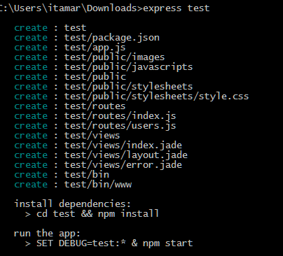
Express server
The easiest way create an Express server is using Express’s server creator
We just type “express <name of the app>” into CMD
And a base client server will be created for us!
(never forget to npm install –g express)
Running the app:
type node ./bin/www
(You can also use package.json to set start command)
Lets dive into its structure…

Slide 4
Express server - Things to remember…
A server is built mainly from three parts:
Routes – anything related to API calls
Logic – anything related to the server itself
DataBase
When dealing with Node,
we take the DataBase out from the server
(as we saw in MongoDb)

Slide 5
Express server
/bin
www
/routes
/views
/js
/css
…
/views
app.js
Bin Folder: the server settings folder
www: (no JS extension!)
The main server file
Holds the server settings
Used to store and create object there are not route oriented

Slide 6
Express server
/bin
www
/routes
/views
/js
/css
…
/views
app.js
Routes Folder:
This is where the routes usually are (but it not mandatory)
It is accustomed that each route category has its own JS file
App.js: (or whichever name you’ll want)
The main routing file
Holds the routing settings
Used to store and manage the routes in the server

Slide 7
Express server
/bin
www
/routes
/views
/public
/js
/css
…
/templates
app.js
Views Folder: (in use with Jade or EJS)
Holds the main server views
We can change the default folder with:
app.set('views', __dirname + '/yourViewDirectory');
Public Folder:
This is where the client side files are
It is accustomed that each file category has its own folder

Slide 8
Config.json
This is the configuration JSON file (see what I did here? hehe)
What is does:
loads the default configuration file;
loads environment specific configuration file and overrides defaults;
and then:
uses environment variables;
and command-line arguments to override data from configuration files.
How to install:
npm install config.json
How to use:
https://www.npmjs.com/package/config.json

Slide 9

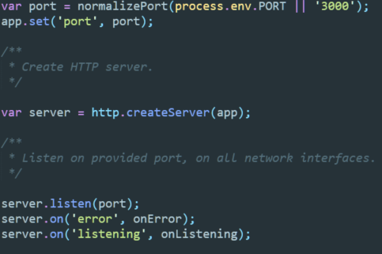
Express server – www file example
Lets use the app file, in app.js we did
We start our server and listen to the port we want
process.env.PORT – tells the system to try and use it default port

Slide 10

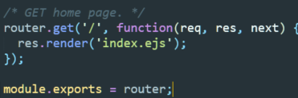

Express server - app.js example
We require the routing files
Home.js example
Then we define when to route to each

Slide 11
Mongo and azure
We need a way to run Mongo backend
There are two ways:
1. mLab – a host for your Database, free up to 0.5Gb
2. Azure VM – running it inside a VM

Slide 12
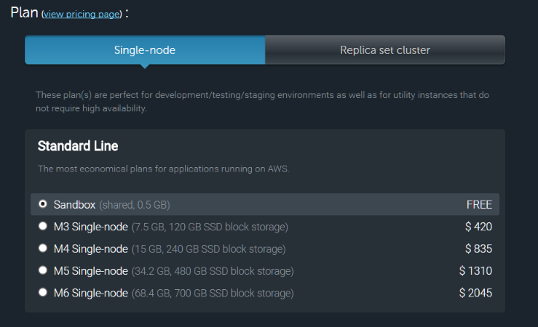

Mlab
mLab is a mongo service
To use mLab:
Go to mLab site
Login
Click Create New
Select free single plan

Slide 13
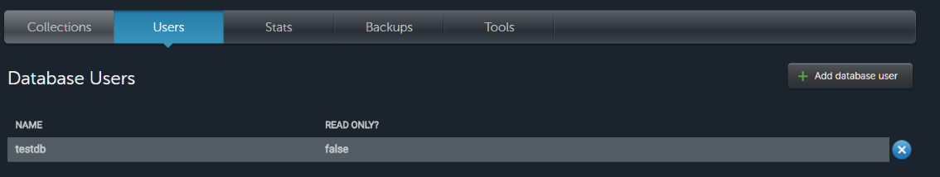

Mlab
Add db user
In Server, connect to

